Slide 1
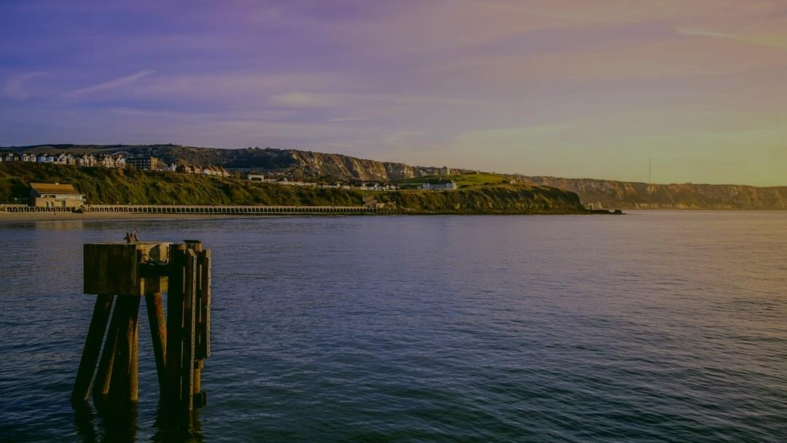

Communicating in a Crisis

Slide 2
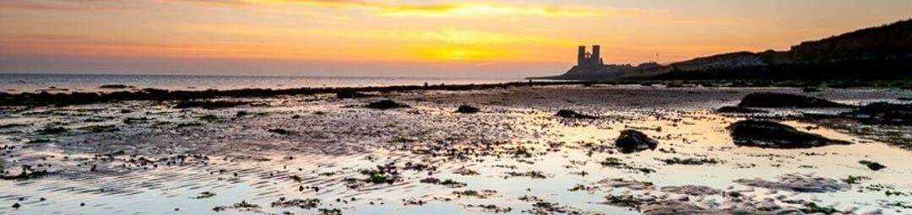
Deirdre Wells OBE
Chief Executive, Visit Kent

Slide 3


Slide 4
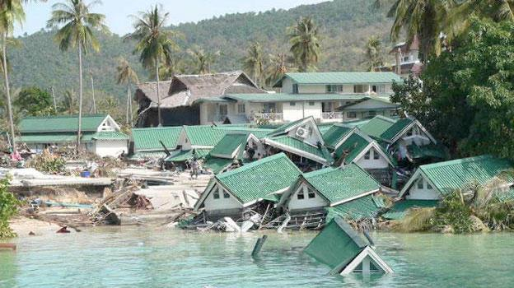

Slide 5
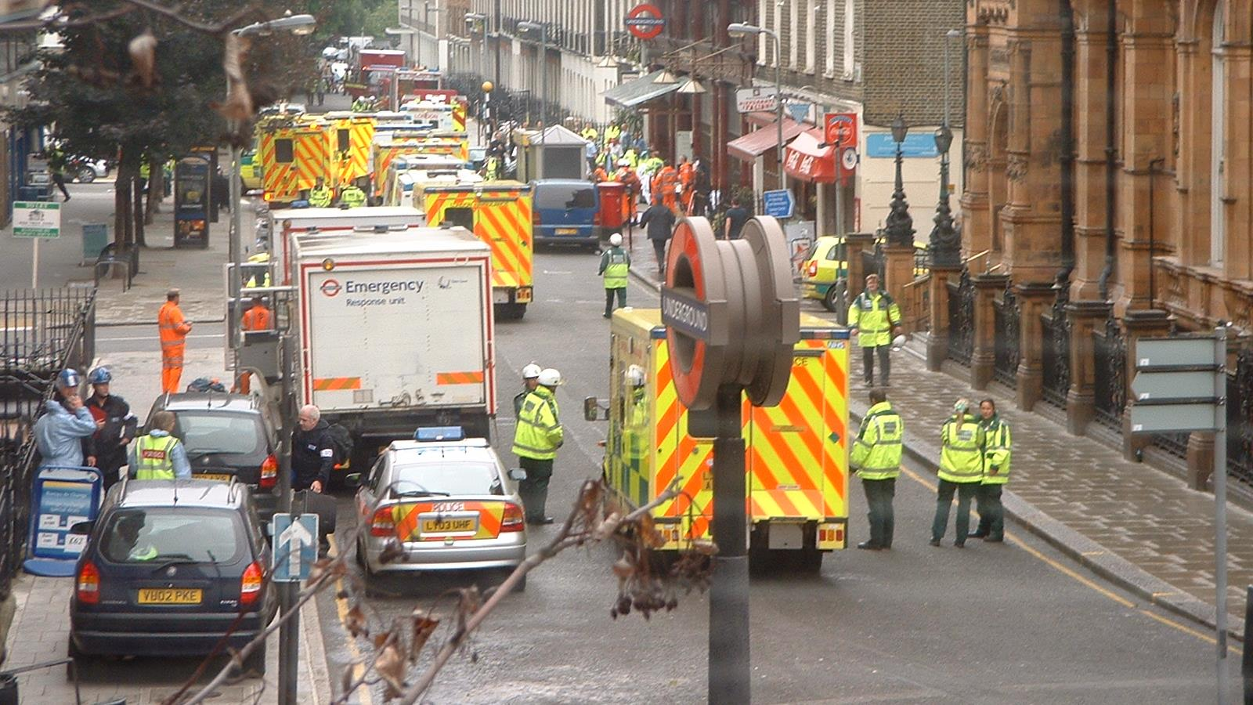

Slide 6
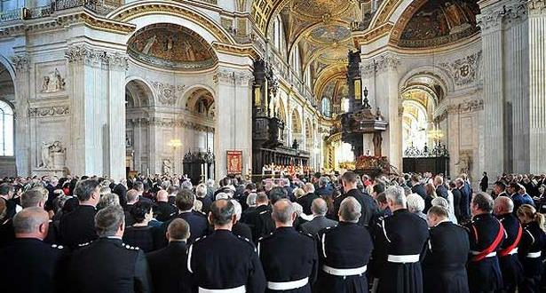
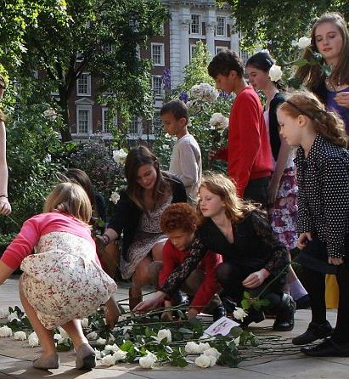
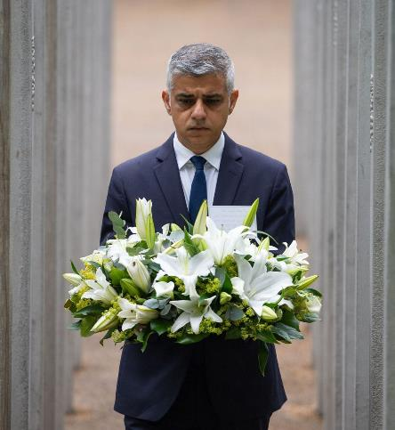
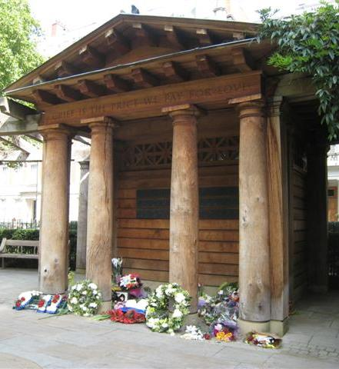

Slide 7
WHAT TO SAY WHEN YOU DON’T KNOW WHAT TO SAY…
Information, information, information
Accurate, timely - don’t blag!
Empathise – but not overly so
Keep calm and don’t catastrophise
Look after your staff
Look after yourself

Slide 8


Slide 9
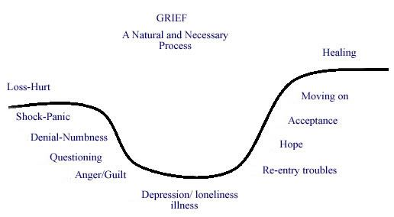

Slide 10


Slide 11
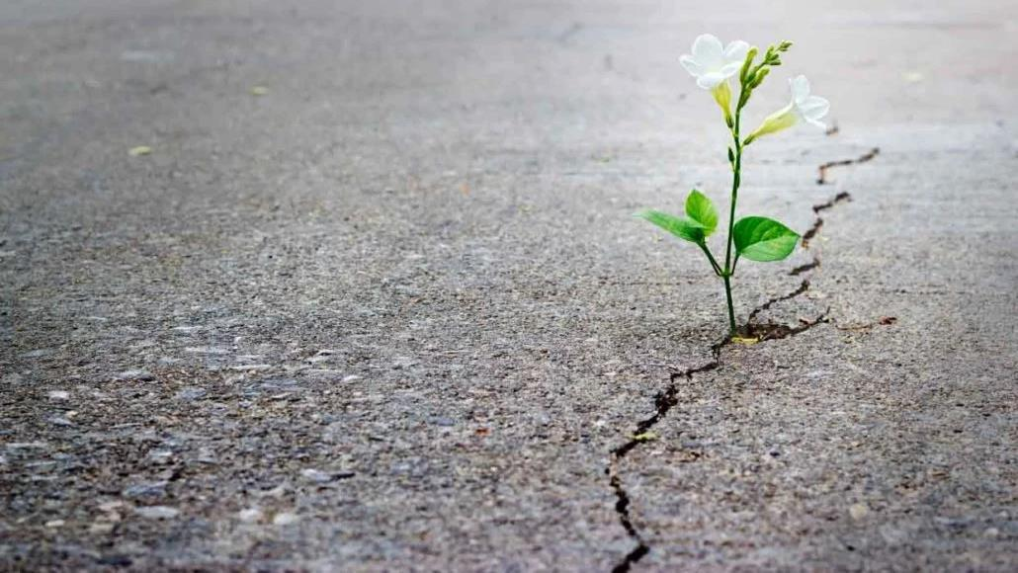

Slide 12
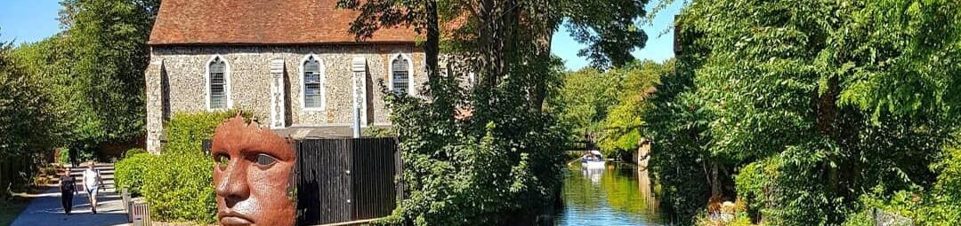
Miranda Chapman
Pillory Barn

Slide 13
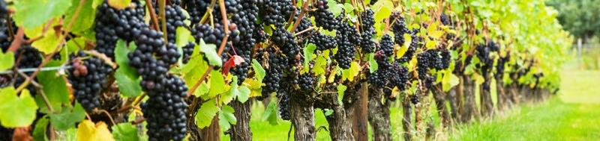
Jim Dawson
Head of Creative Digital and Marketing

Slide 14
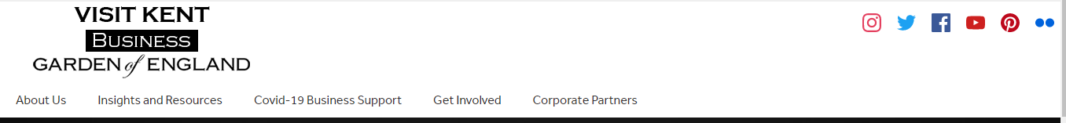
https://www.visitkentbusiness.co.uk/
Government & Industry Updates
Funding & Financial Support
Destination Recovery
Insights & Lobbying
Training & Resources

Slide 15
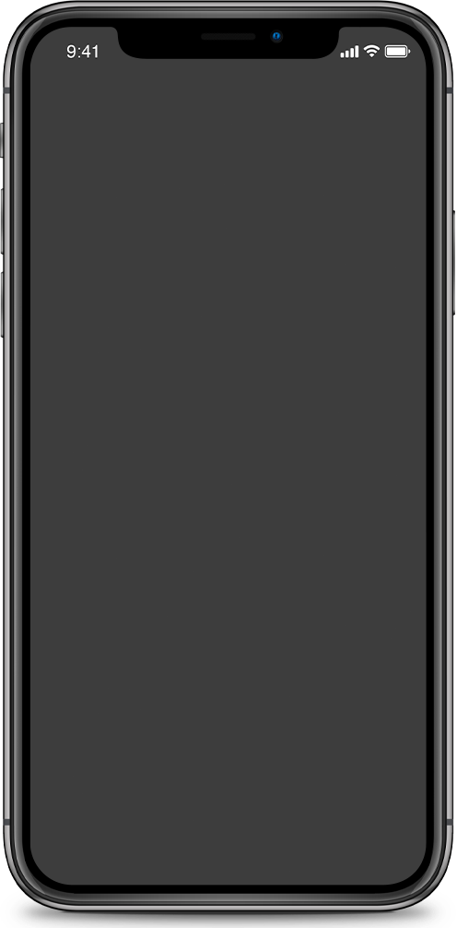

Visit Kent Consumer Messaging
Focus across our B2C channels will be supporting local businesses:
  Businesses going that extra mile
  Local produce
  Local heroes
  General inspirational content

Slide 16
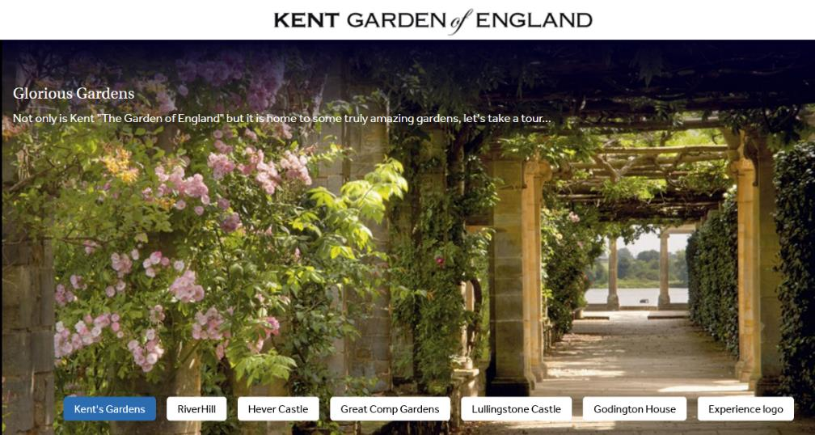
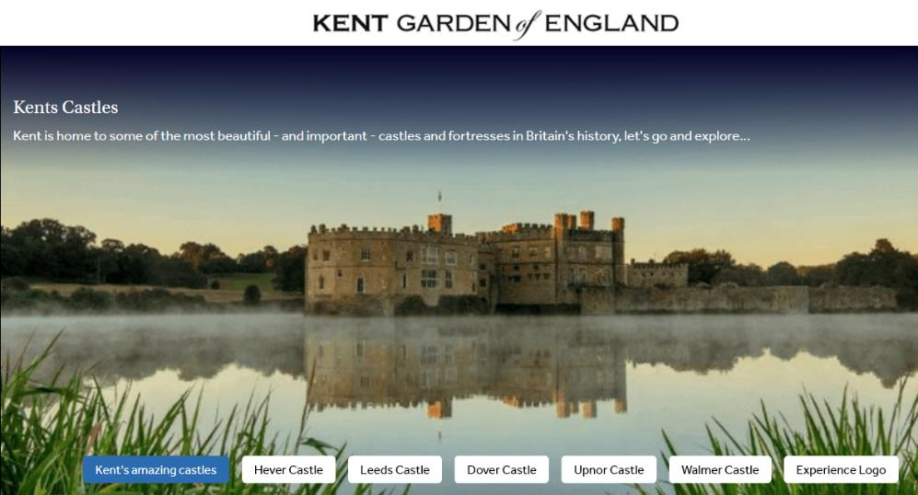
Virtual Kent
Creating content now is a challenge but not impossible.
  Development is taking place on the Visit Kent platform allowing us to aggregate existing content (Google/web cams/video)
  Curated, thematic virtual tours
  Now is the time to create or update your Google Business Listing and add good quality photography

Slide 17
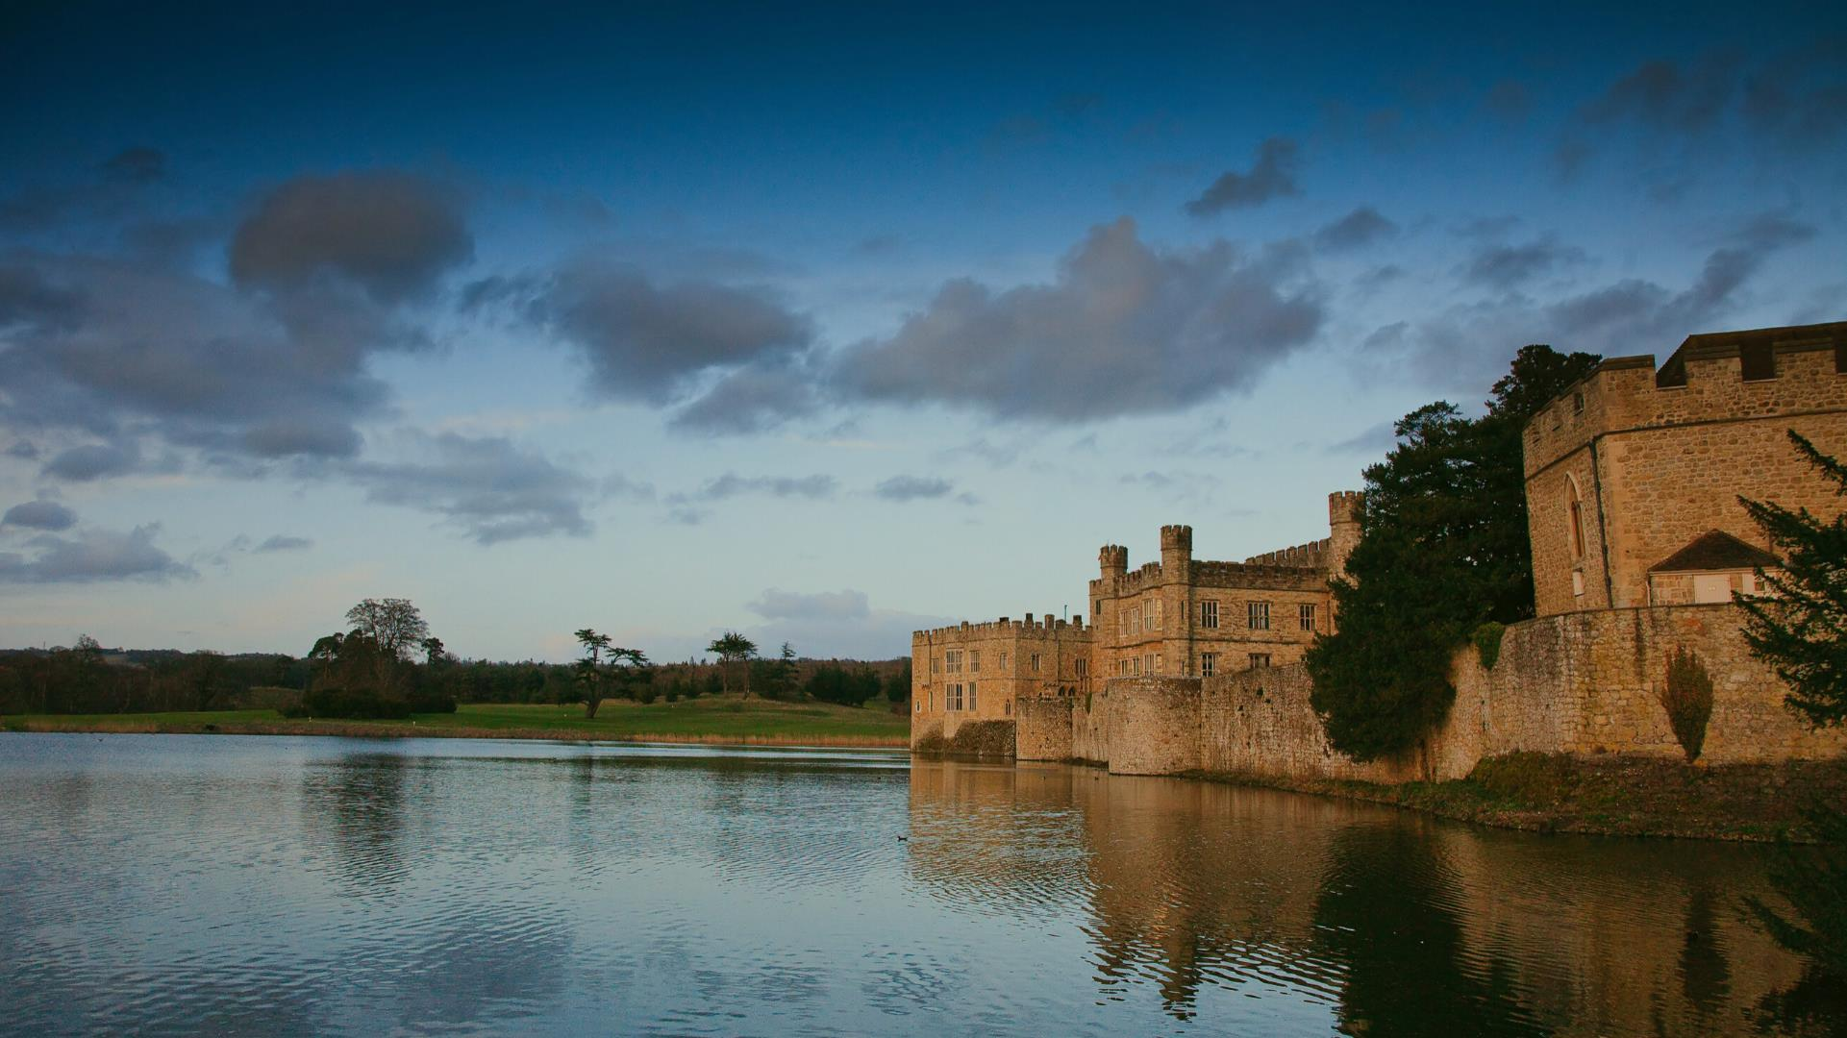

DESTINATION RECOVERY

Slide 18


Interreg France Channel England programme targeted project
EXPERIENCE Project
Experiential tourism offer to
extend the visitor season
Interreg Channel Experience
    SO 3.1: Realise potential of common natural and cultural assets to deliver innovative and sustainable growth
Notes:
Match funding partners:
- Kent County Council
- Ashford Borough Council
Canterbury City Council
Dover District Council
Gravesham Borough Council
Medway Council
Thanet District Council
Tunbridge Wells Borough Council

Slide 19
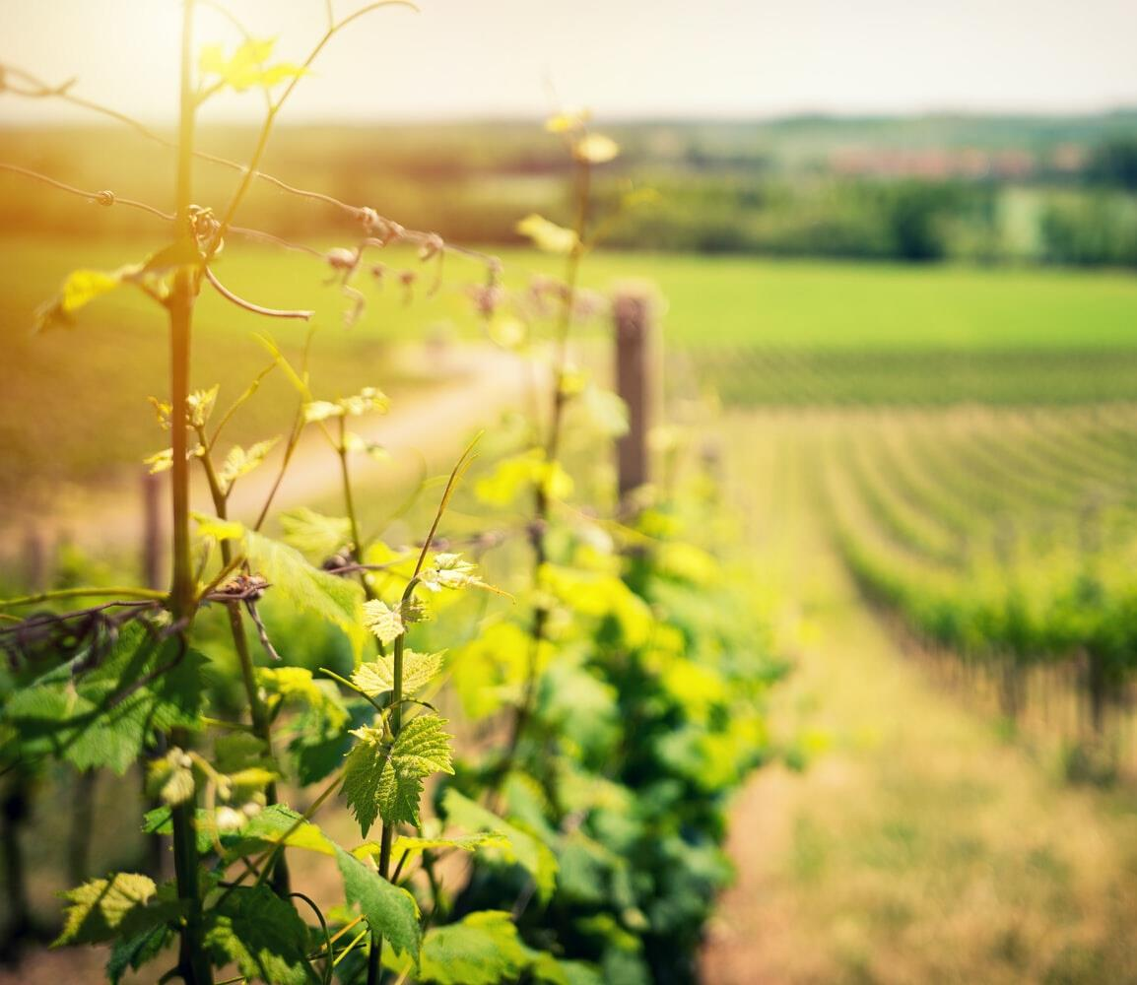

Project Aims
1
To extend the tourism season and increase visitor spend
2
To improve the sustainability of tourism and
reduce the negative social and environmental impacts
3
To develop and implement new products and services to attract over new visitors

Slide 20
Supporting Recovery
Place sustainable tourism at the heart of the recovery strategy
Opportunity to develop more authentic visitor experiences to meet demand
Capitalise on the immediate interest in outdoors, active, wellbeing and rural product
Increased interest in local produce and supporting independent businesses
Focus on a strong off season product will support future resilience and growth
Notes:
Experience will be central to our recovery strategy
Reset and build sustainability into the recovery
We expect Covid-19 to magnify the already emerging trend for experiential, authentic product
Capitalise on the immediate interest in outdoors, active, wellbeing and rural product as well as the increase in wanting to buy local produce and support independent businesses
Focus on off season product will be key to build in resilience and regrowth
This programme will help to deliver some of the key things we’ll need to recover:
Collaboration between businesses
New product development which meets consumer demand in the “New Normal”
Training for businesses
Research into businesses, consumers and impact (social, environmental and economic)
B2C marketing to drive domestic visits
New destination imagery

Slide 21

Notes:
A key part of this will be our product development programme which will help businesses to take a new or adapted product idea, develop it, test it and take it to market.
Perfect for businesses that are thinking about how to adapt their product to help rebuild business following lockdown

Slide 22
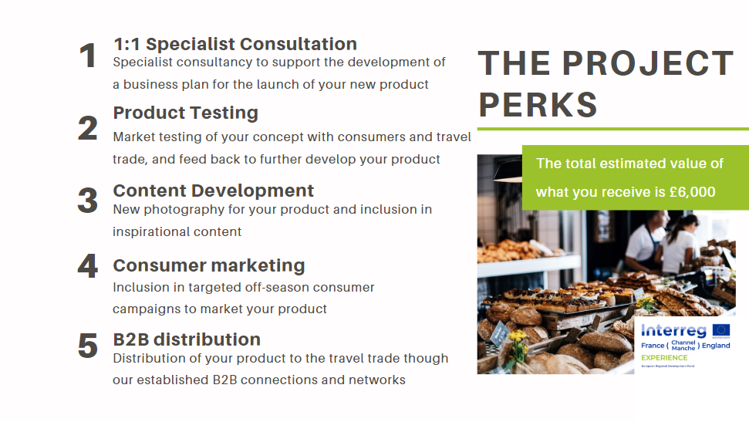
Notes:
The process:
- We will be developing lots of content for your new product, including videos, images and content. You will also have full access to all the content we develop for you
- You will receive 1:1 specialist consultation to help you in developing your new product. This is an extremely valuable opportunity to sit with an industry expert and receive a step by step breakdown in developing your product
- We will take your product to market to test, this is a great opportunity to identify if the product will sell or not and an opportunity to feed back any comments to you so tweaks can be made before launching your new product. We will test your product through campaigns , travel trade and consumer working groups.
- Lastly, we will support you with marketing activity. We will market your product through the travel trade, B2B market if relevant and also through our dedicated consumer campaigns on the Visit Kent channels

Slide 23

REGISTER YOUR INTEREST NOW!
If this is something you would like to take part in the EXPERIENCE development programme or would like more information, please contact the Visit Kent team on enquiries@visitkent.co.uk
Notes:
If this is something you would like to take part in the EXPERIENCE development programme or would like more information, please contact the Visit Kent team via the enquiry's inbox

Slide 24
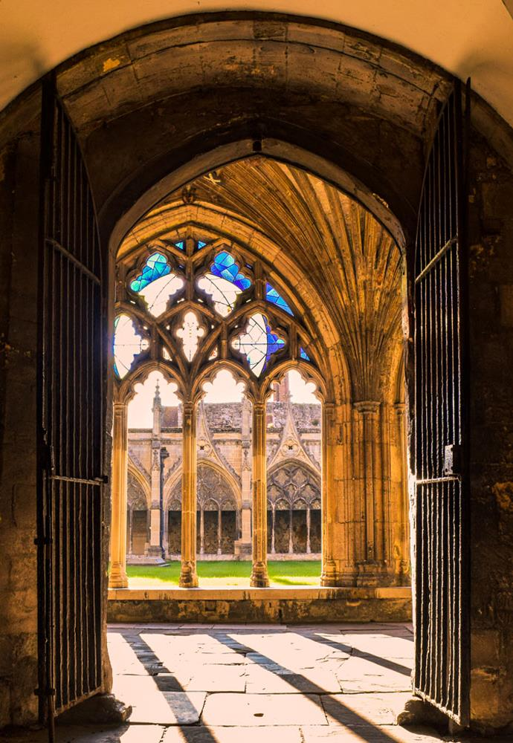
Upcoming Sessions
Monday 1st June 14:00-16:00
Maximising Opportunities Across Google Solutions, delivered by Sleeping Giant Media

