Slide 1


Visit Kent
June 11, 2021
An opportunity to begin discussing the insights from our consumer testing campaign
Consumer Testing Insights

Slide 2
Visit Kent
June 11, 2021
1
Introduction
Today's
Agenda
2
Campaign overview
3
YouGov data
4
Themes
5
Discussion

Slide 3
1
Who are the consumers?
Questions to think about
2
What are they interested in?
3
Where are they?
Creative Experiences
Food and Drink
History and Culture
4
What encourages them to act?

Slide 4
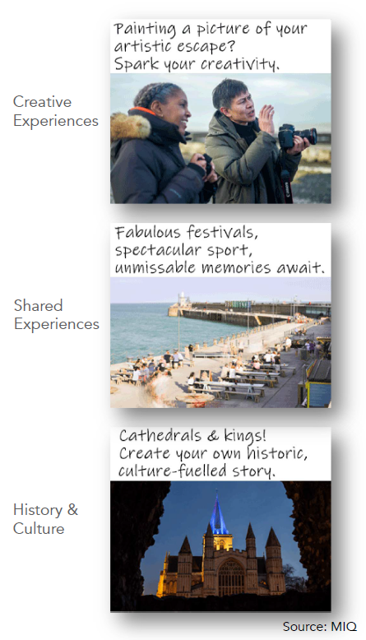
About the campaign activity
  Ads across 8 themes
  2.5 hr drive radius, April 2021
  10.7M impressions/9K clicks
  Testing audience response to
    Theme
    Message
    Ad format
  YouGov Survey

Slide 5
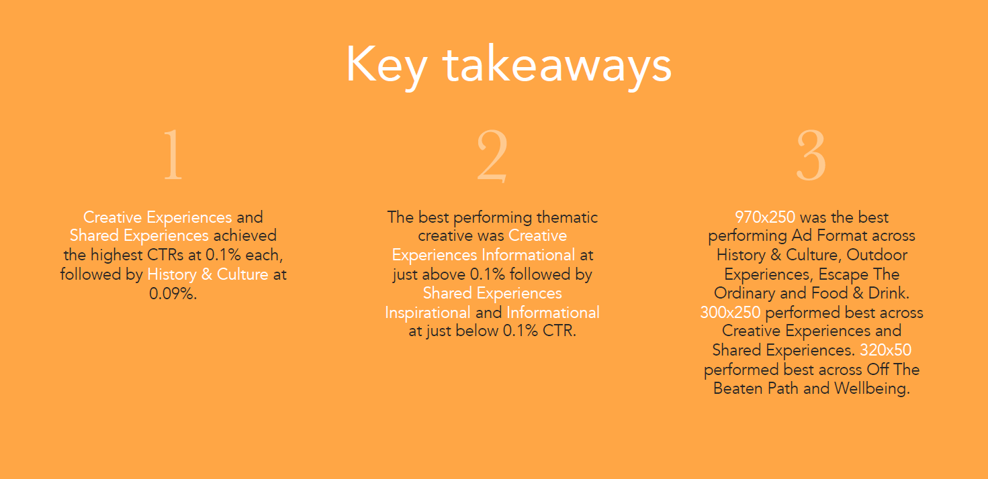

Slide 6

YouGov Brand Study
4 questions
4,000 respondents
2,000 control group
(respondents who have not been exposed to campaign ads)
2,000 exposed group
(respondents who have been exposed to campaign ads)

Slide 7
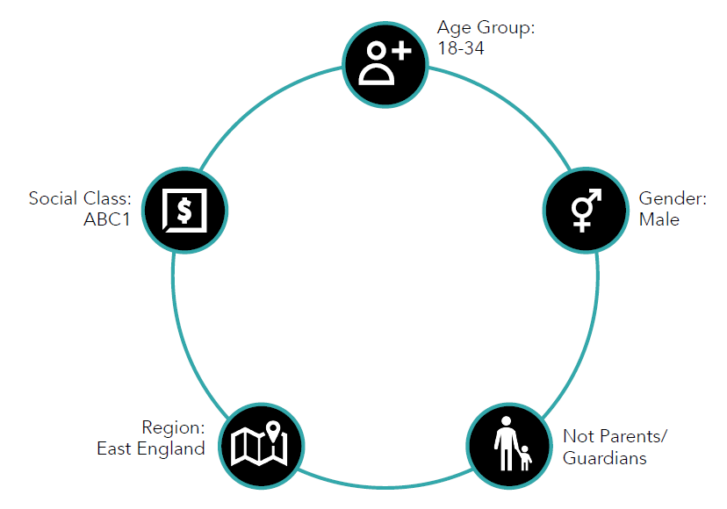
Assuming that appropriate health and safety measures and social distancing procedures
were in place, in light of the Coronavirus (COVID-19) pandemic...
Q1. Overall, to what extent, if at all, would you feel comfortable travelling around the UK for
leisure purposes this year (i.e., in 2021), once travel rules are lifted?
80%
80
71%
25-44
60
40
26%
20
18%
0
Comfortable
Not comfortable
Don't know
Control
Exposed
Who are most likely to be comfortable travelling for leisure purposes?

Slide 8
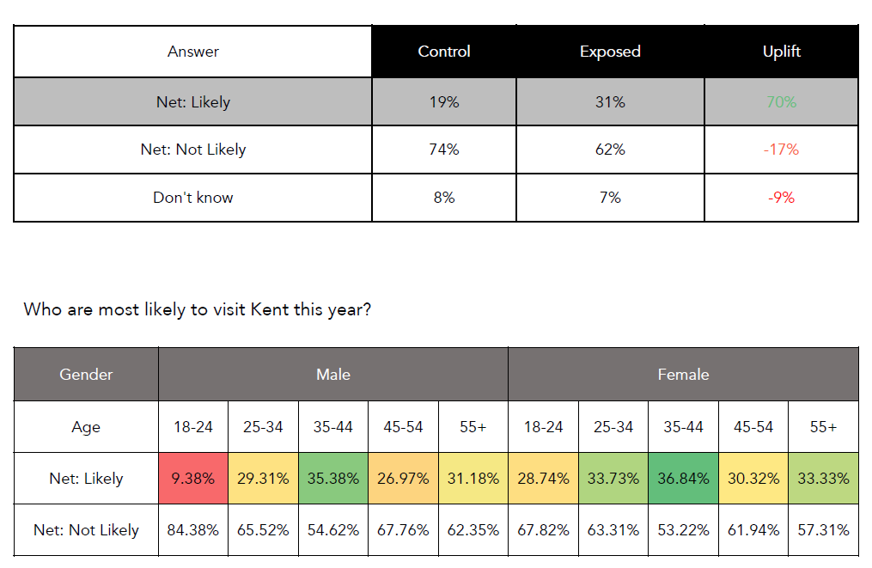
Q2. How likely, if at all, are you to visit Kent as a tourist this year (i.e., in 2021)?
40%
36.2%
34%
30%
20%
10%
0%
Beaten path
Creative
Food
History
Wellbeing
Escape ordinary
Outdoor experiences
Shared experiences
Which creative saw the best performance in terms of exposed users being most likely to visit Kent this year?

Slide 9
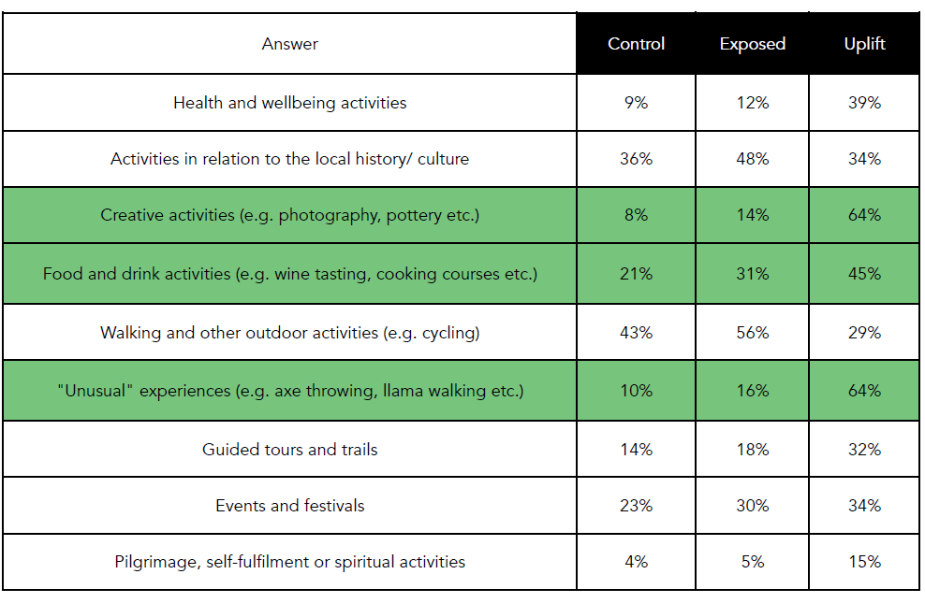
Q3. Which, if any, of the following types of activities would you consider doing/attending
in Kent at any point in the future? (Please select all that apply)
  The activities in green are generating the highest uplift.
  There is a significant market and appeal for local history/culture, outdoor activities and events & festivals.
  Looking specifically at respondents who indicated that are likely to visit Kent, the top three activities they would consider doing are Outdoor activities (72%), Local history/culture (56%), and Food and drink (37%).

Slide 10
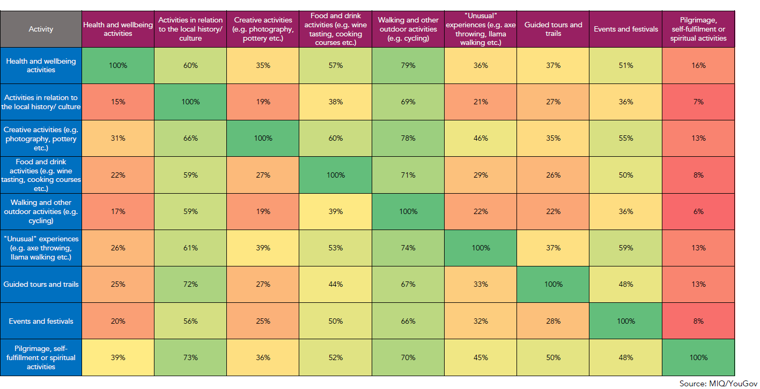
Q3 what combination of activities were chosen together?

Slide 11
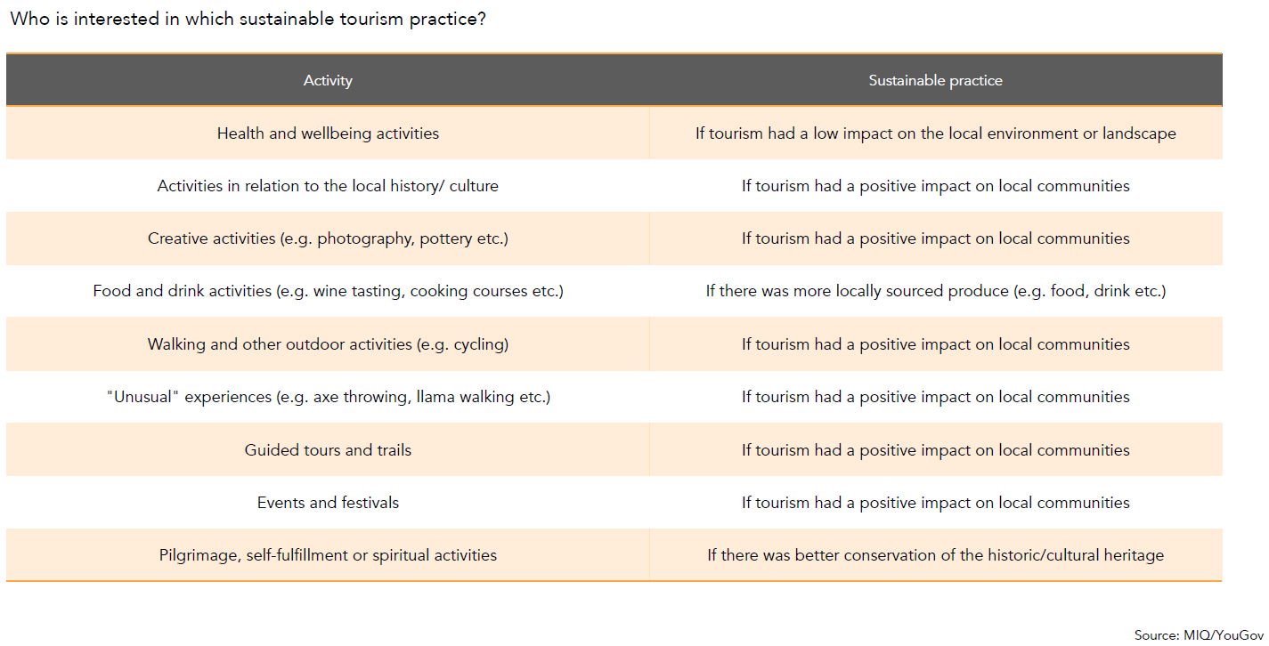
Q4. Which, if any, of the following sustainable tourism practices would increase your
interest in visiting Kent as a tourist at any point in the future?
  All practices had a comparable share of responses, but the highest share was seen for practices that would have a positive impact on local communities.
  Younger females are more likely to be interested in sustainable practices whereas younger or older males (excluding 35-54) were more likely to be interested.

Slide 12
Creative Experiences

Slide 13
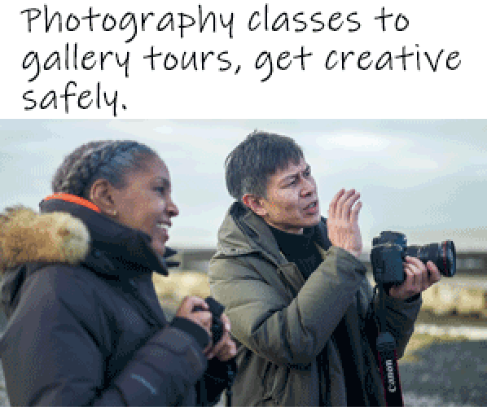
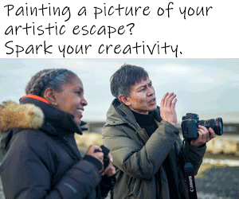
Theme messaging
Informational
Inspirational
681 clicks/0.105%CTR
621 clicks/0.094%CTR
The best performing creative was Informational which achieved a 0.105% CTR which also had the most on-site engagement.
Ad Content | Bounce Rate | Pages/Session | Avg. Session Duration
Inspirational | 90.42% | 1.16 | 20.06
Informational | 88.10% | 1.23 | 18.62
Source: Hotjar; MIQ

Slide 14
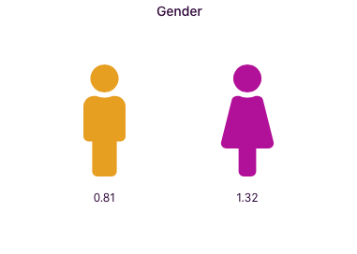
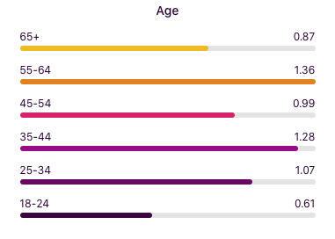
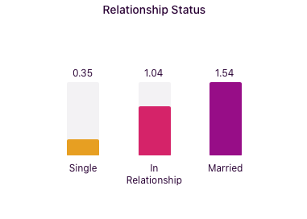
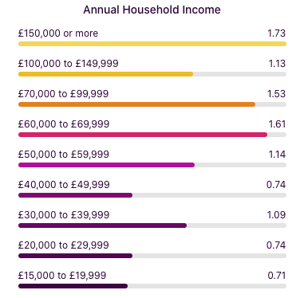
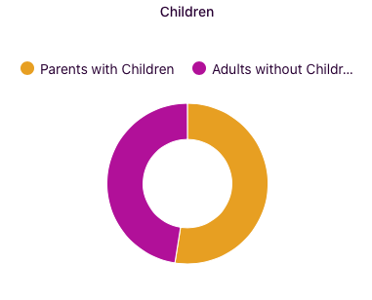
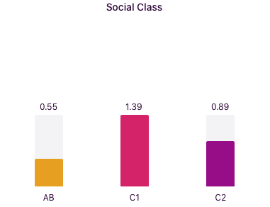
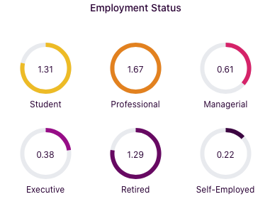
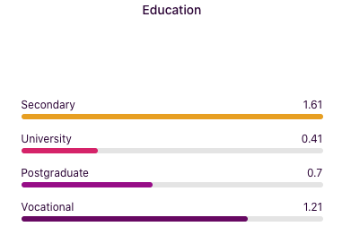
Demographics
The highest index age groups are 35-44 and 55-64 with women indexing higher than men. They are more likely to be married with a £150K HHI, and C1 socio-economic group.
Most interest comes from
Kent
Essex
Cambridgeshire
West Sussex
Buckinghamshire
Oxfordshire
Bedfordshire
Hampshire
Top 10 statuses and interests
Eyeota - Demo - Employment Status - Changed Jobs
Eyeota - Lifestyle - Interest - Hobbies - Graphic and Design
Eyeota - Arts and Sciences - Interest - Social Sciences and Humanities - Arts and Sciences
Eyeota - Entertainment - Interest - Online Media - Gossip and Celebrities
Eyeota - Demo - Life Events - Education Seekers
Eyeota - Eyeota Reach - Demographic - Life Events - Real Estate Intenders
Eyeota - Interest - Fashion and Beauty - Fashion
Eyeota - Health and Fitness - Interest - Pharmacy and Medicine
Eyeota - Lifestyle - Owner - Pets
Eyeota - Arts and Sciences - Interest - Social Sciences and Humanities - History
Source: MIQ Hub

Slide 16
On-site behaviour and user flow
Gender | Age | Sessions | Bounce Rate | Pages/Session | Avg. Session Duration
male | 18-24 | 46 | 86.96% | 1.20 | 16.20
female | 18-24 | 26 | 84.62% | 1.12 | 16.50
male | 25-34 | 91 | 97.80% | 1.03 | 1.54
female | 25-34 | 48 | 87.50% | 1.33 | 19.10
female | 35-44 | 37 | 83.78% | 1.19 | 109.95
male | 35-44 | 36 | 77.78% | 1.44 | 44.92
female | 45-54 | 34 | 85.29% | 1.18 | 20.71
male | 45-54 | 24 | 91.67% | 1.13 | 0.96
female | 55-64 | 31 | 90.32% | 1.10 | 28.00
female | 65+ | 30 | 70.00% | 1.40 | 48.37
The most sessions came from male 25-34.The most engaged group is female 65+ followed by male 35-44.
Heatmaps
The top theme buttons by cursor movement (viewing) were:
Shared Experiences (best on mobile)
History & Culture
Escape The Ordinary
Outdoor Experiences
The landing page of this theme - www.visitkent.co.uk/visit-kent-blog/creative-experiences-in-kent had a drop off rate of 50% with the users not going any further on the website.
Shared Experiences
Subdomain URL | User Share
www.visitkent.co.uk/visit-kent-blog/shared-experiences | 6.41%
www.visitkent.co.uk/visit-kent-blog/escape-the-ordinary | 6.11%
www.visitkent.co.uk/visit-kent-blog/experience-health-and-wellbeing | 3.55%
www.visitkent.co.uk/visit-kent-blog/experience-food-and-drink | 3.35%
www.visitkent.co.uk/visit-kent-blog/experience-history-and-culture | 3.06%
www.visitkent.co.uk/visit-kent-blog/experiences-off-the-beaten-track | 2.86%
History & Culture
Health & Wellbeing
Food & Drink
Off The Beaten Track
Creative Experiences
Escape The Ordinary
Source: Google Analytics; MIQ
Notes:
Recommendations:
Steer towards an Informational message
Ladies do index higher but men between 35-44 are engaged and that is the highest indexing age group.
Strong secondary links to Outdoor activities, history/culture, food and drink

Slide 17
Food & Drink

Slide 18
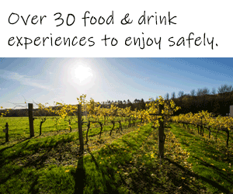

Theme messaging
Informational
Inspirational
532 clicks/0.064%CTR
558 clicks/0.068%CTR
The best performing creative was Inspirational which achieved a 0.068% CTR. However, Informational had the most on-site engagement.
Ad Content | Bounce Rate | Pages/Session | Avg. Session Duration
Inspirational | 90.23% | 1.13 | 24.07
Informational | 90.10% | 1.20 | 25.81
Source: Hotjar; MIQ

Slide 19
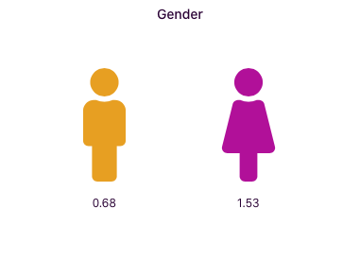
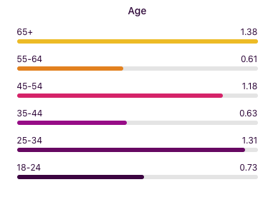
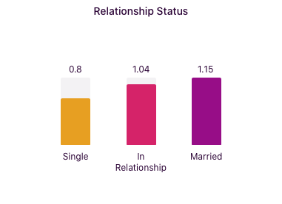
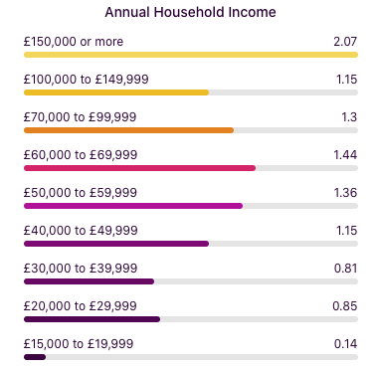
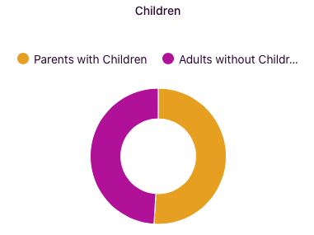
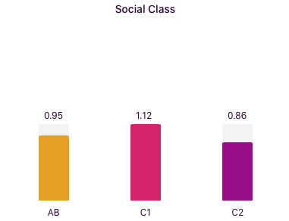
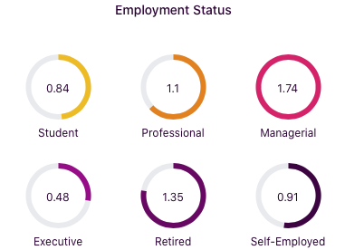
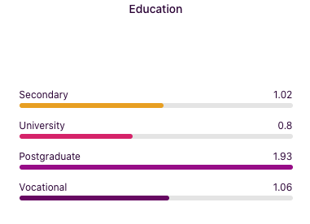
Demographics
Top 10 statuses and interests
VisualDNA Entertainment - Entertainment - Movie Behaviours - Deciding Factor - Critic Reviews
VisualDNA Brand - Brand - Department Stores - John Lewis
VisualDNA Brand - Brand - Social Media - LinkedIn
eXelate Smart Segments - Entertainment Seekers
VisualDNA Brand - Brand - Fast Food - McDonalds
VisualDNA Entertainment - Entertainment - Movie Genre Interest - Animation Movie Watcher
VisualDNA Retail & Consumer Goods - Retail & Consumer Goods - Single Serve Coffee Machine Owner
VisualDNA Lifestyle - Lifestyle - Health - Good Habits - Limits sugar consumption
Eyeota - Entertainment - Interest - Books
VisualDNA Finance - Finance - Banking - Access Internet Banking via Tablet
Most interest comes from
Kent
Essex
West Sussex
Buckinghamshire
Bromley
Females index the highest with 25-34 and 65+, the highest indexing age groups. They index highly for being married, and having higher end HHI, particularly £150K or more. They tend to be C1 socio-economic group.
Source: MIQ Hub
Notes:
Females index higher again.
Split between young and older.
McDonalds as an outlier
Even split between those with/without children

Slide 21
On-site behaviour and user flow
Gender | Age | Sessions | Bounce Rate | Pages/Session | Avg. Session Duration
female | 18-24 | 37 | 94.59% | 1.03 | 15.65
female | 25-34 | 81 | 85.19% | 1.20 | 41.49
male | 25-34 | 50 | 94.00% | 1.04 | 2.50
female | 35-44 | 61 | 90.16% | 1.08 | 7.74
male | 35-44 | 43 | 88.37% | 2.23 | 63.63
female | 45-54 | 52 | 80.77% | 1.33 | 77.44
male | 45-54 | 19 | 84.21% | 1.26 | 78.95
female | 55-64 | 43 | 81.40% | 1.49 | 39.93
female | 65+ | 36 | 72.22% | 1.50 | 129.94
male | 65+ | 23 | 69.57% | 1.39 | 50.57
Heatmaps
The top theme buttons by cursor movement (viewing) were:
Off The Beaten Track
Escape The Ordinary
Outdoor Experiences
History & Culture
The most sessions came from female 25-34.
The most engaged group is male and female 65+.
The landing page of this theme - www.visitkent.co.uk/visit-kent-blog/experience-food-and-drink had a drop off rate of 38% with the users not going any further on the website.
Subdomain URL | User Share
www.visitkent.co.uk/visit-kent-blog/shared-experiences | 4.77%
www.visitkent.co.uk/visit-kent-blog/experience-health-and-wellbeing | 3.36%
www.visitkent.co.uk/visit-kent-blog/experience-history-and-culture | 2.12%
www.visitkent.co.uk/visit-kent-blog/creative-experiences-in-kent | 1.86%
www.visitkent.co.uk/visit-kent-blog/7-places-to-find-bluebells-in-kent | 1.41%
www.visitkent.co.uk/whats-on/search-events | 1.41%
Shared Experiences
History & Culture
Health & Wellbeing
Food & Drink
Creative Experiences
Source: Google Analytics; MIQ
Notes:
Females index higher again.
Split between young and older although 65+ most engaged
McDonalds as an outlier
Even split between those with/without children
Secondary link to Outdoor activities, History and culture, Events/Festivals

Slide 22
History & Culture

Slide 23
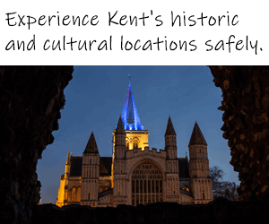
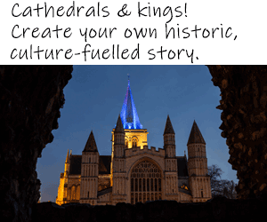
Theme messaging
Informational
Inspirational
742 clicks/0.087%CTR
724 clicks/0.085%CTR
The best performing creative was Informational which achieved a 0.087% CTR. Informational also had the most on-site engagement.
Ad Content | Bounce Rate | Pages/Session | Avg. Session Duration
Inspirational | 90.59% | 1.19 | 17.01
Informational | 87.55% | 1.27 | 28.54
Source: Hotjar; MIQ

Slide 24

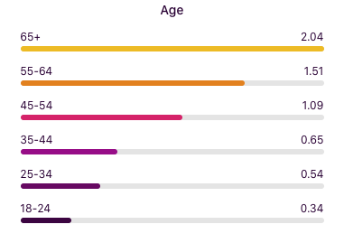
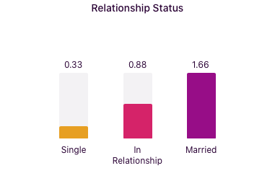
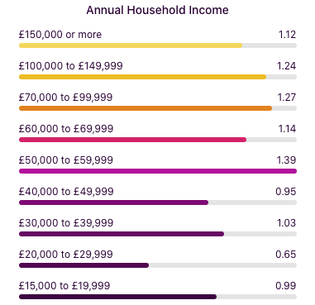
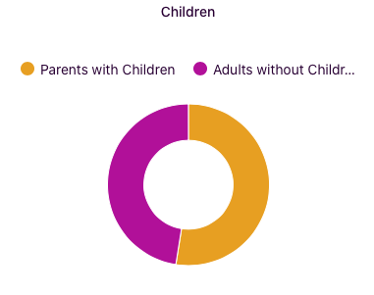
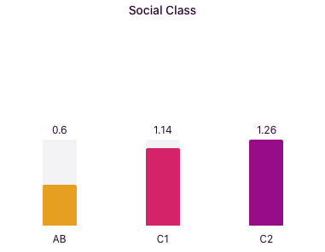
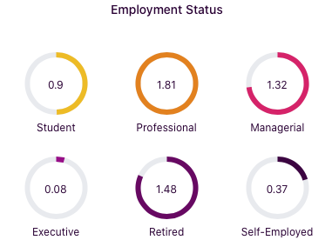
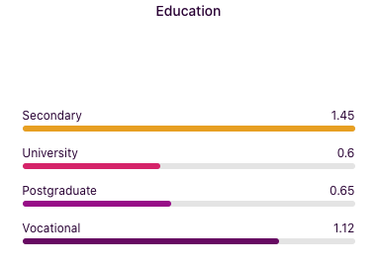
Demographics
Women index higher than men at 1.26 with 65+ followed by 55-64 the highest indexing age groups. They’re more likely to be married and have £50-60K HHI. They’re more likely to be C1 and C2 social class.
Most interest comes from
Kent
East Sussex
Buckinghamshire
Bromley
Suffolk
Essex
Bedfordshire
Oxfordshire
Top 10 statuses and interests
Eyeota - Sports - Interest - Horse Racing
Eyeota - Arts and Sciences - Interest - Social Sciences and Humanities - Ecology
Eyeota - Consumer Electronics - Interest - Video Games - Genre - Action and Adventure
Eyeota - Politics - Interest - US Politics
Eyeota - Arts and Sciences - Interest - Social Sciences and Humanities - Architecture
Eyeota - Entertainment - Interest - Audio - Podcasts
Eyeota - Travel - Interest - Destinations - Africa
Eyeota - Sports - Interest - Cricket
Eyeota - Sports - Interest - Indoor Sports - Volleyball
Eyeota - Arts and Sciences - Interest - Sciences - Biology
Source: MIQ Hub

Slide 26
On-site behaviour and user flow
Gender | Age | Sessions | Bounce Rate | Pages/Session | Avg. Session Duration
female | 18-24 | 30 | 70.00% | 1.57 | 45.63
male | 25-34 | 53 | 90.57% | 1.23 | 50.02
female | 25-34 | 33 | 93.94% | 1.33 | 2.21
female | 35-44 | 53 | 88.68% | 1.25 | 38.04
male | 35-44 | 36 | 91.67% | 1.44 | 7.92
female | 45-54 | 43 | 86.05% | 1.23 | 22.37
male | 45-54 | 33 | 81.82% | 1.36 | 21.48
female | 55-64 | 58 | 87.93% | 1.38 | 18.02
female | 65+ | 72 | 77.78% | 1.61 | 91.21
male | 65+ | 30 | 80.00% | 1.13 | 29.13
Heatmaps
The top theme buttons by cursor movement (viewing) were:
Escape The Ordinary
Shared Experiences
Outdoor Experiences
Off The Beaten Track
Creative Experiences
The most sessions came from female 65+.
The most engaged group is female 65+ followed by female 18-24.
The landing page of this theme - www.visitkent.co.uk/visit-kent-blog/experience-history-and-culture had a drop off rate of 26% with the users not going any further on the website.
Shared Experiences
Subdomain URL | User Share
www.visitkent.co.uk/visit-kent-blog/shared-experiences | 11.02%
www.visitkent.co.uk/visit-kent-blog/experience-health-and-wellbeing | 5.71%
www.visitkent.co.uk/visit-kent-blog/experience-food-and-drink | 3.95%
www.visitkent.co.uk/visit-kent-blog/escape-the-ordinary | 3.67%
www.visitkent.co.uk/visit-kent-blog/creative-experiences-in-kent | 2.99%
www.visitkent.co.uk/visit-kent-blog/outdoor-experiences | 2.68%
Health & Wellbeing
Food & Drink
Creative Experiences
Outdoor Experiences
History & Culture
Escape The Ordinary
Source: Google Analytics; MIQ
Notes:
Predominantly female audience
Again split between young and old. Young (18-24) women is a surprise in terms of engagement.
Strong secondary link to Outdoor activities

Slide 27
1
Who are the consumers?
Up for Discussion
2
What are they interested in?
3
Where are they?
Has what you first thought changed?
4
What encourages them to act?
Notes:
In general
There are trends but no clear personas painted, except maybe for Health and Wellbeing which very clearly skews towards women over 65 who spend on high end accommodation and are high end shoppers
It also potentially raises more questions than it answers eg: An informational message generates slightly more clicks and a longer dwell tie but how does the inspirational message affect intent as see in the you gov survey.
And
Why do young women show a higher dwell for History/Culture but that sector on the whole indexes lower across the board.
What we do know is that there is appetite for all themes and across a range off ages and social positions.
Also that from a sustainability angle people respond to product that has a [positive impact on local communities

